Slide 1
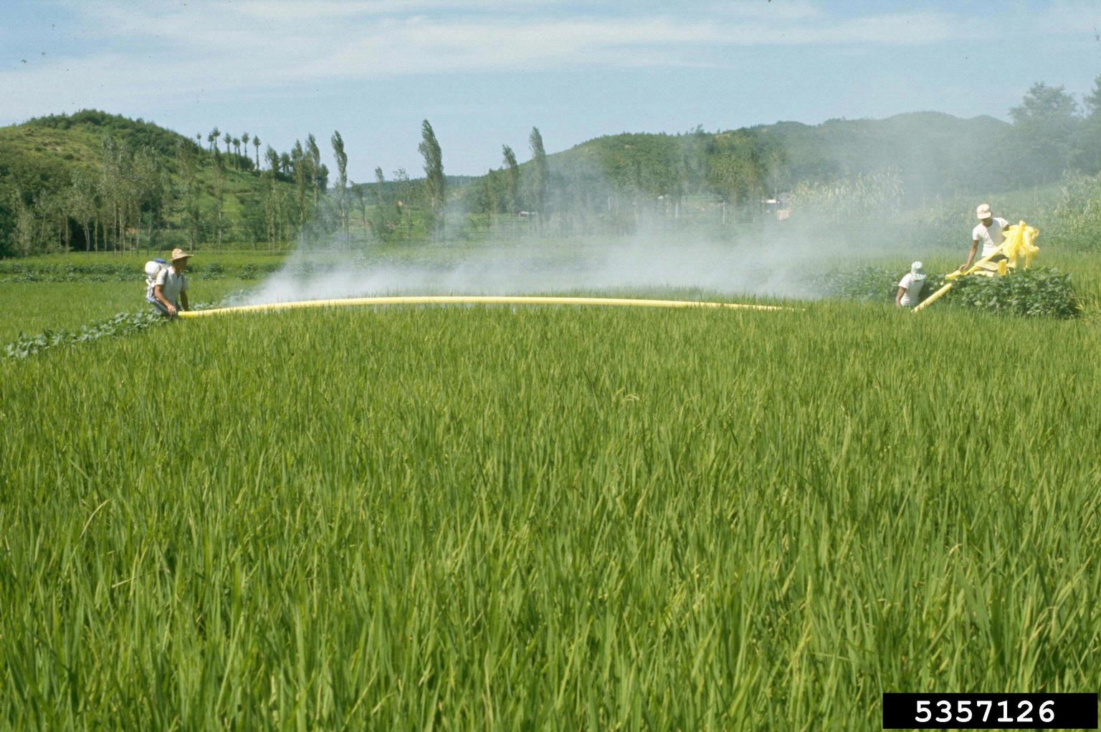


Department of Artificial Intelligence and Machine
Learning
AUTOMATIC SPRAYING PESTICIDES IN
AGRICULTURE
Artificial Intelligence Mini Project
This Photo by Unknown Author is licensed under CC BY

Slide 2

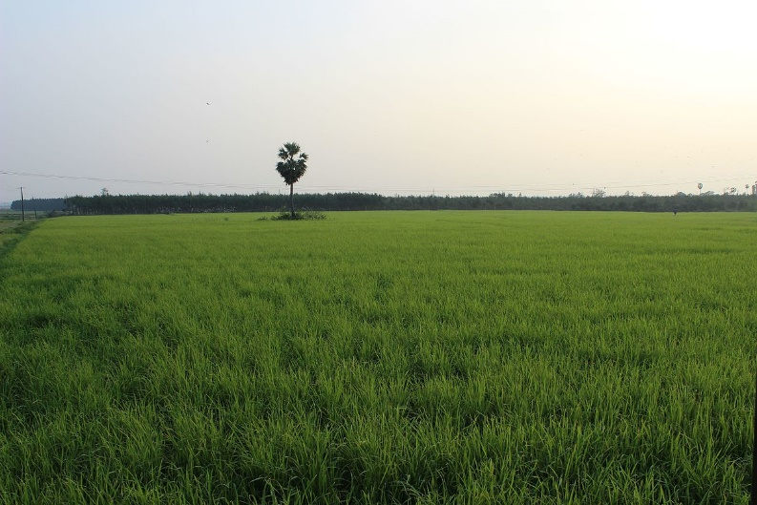
INDEX
INDEX
1
Introduction
2
Principle
3
Features
4
Code and Sample Output
5
Applications
6
Conclusion
This Photo by Unknown Author is licensed under CC BY-SA

Slide 3
Introduction
Automatic spraying of pesticides involves the use of mechanized systems to apply pesticides to crops or specific sensors GPS technology and actuators to precisely control the distribution of pesticides.
This method enhances efficiency ,reduces labor requirements and ensures more targeted application ,minimizing environment impact Automated spraying systems are integral to modern agriculture optimizing resource utilization.
This method enhances efficiency ,reduces labor requirements and ensures more targeted application minimizing environment impact .Automated spraying systems are integral to modern agriculture, optimizing resource utilization.

Slide 4
Principle
The principle of automatic pesticides involves the use of advanced technologies and automation to optimize the application of pesticides in agriculture. The main principles guiding automatic pesticide application.
Automatic pesticide systems utilize various sensors, including cameras, environmental sensors, and possibly drones, to collect real-time data from the agricultural field. These sensors provide information on crop health, pest presence, and environmental conditions.
Automatic pesticide systems often incorporate variable rate application, meaning that different areas of the field receive different amounts of pesticides based on specific needs. This adaptability improves resource efficiency. Automatic pesticide systems often incorporate variable rate application, meaning that different areas of the field receive different amounts of pesticides based on specific needs. This adaptability improves resource efficiency.

Slide 5
Features
MULTI-FUNCTIONALITY:
Some machines may have additional functionalites such as addition to fertilizers or agriculture inputs.
AUTO-STEERING SYSTEMS:
Implements auto steering mechanisms for precise vehicle navigation within the field reducing the improving accuracy.
AUTOMATION:
Reduces the need for manual intervention enhancing efficiency and reducing labor requirements.
CUSTOMIZATION:
Offers flexibility in adjusting the parameters to suit specific crops field pest pressured.

Slide 6
Code
import random
import time
class Pesticide System:
def _int_(self, total plants)
self total plants = total plants
self treated plants = 0
self pest detected = False
self pesticides prayer = False
def detect-pest (self):
self pest detected = random choice([True, False])
print("Spraying pesticides on plant...")
Time Sleep(2) # Simulate the time it takes to spray pesticides
print("Pesticides sprayed on plant.")
Self pesticide sprayer = False
self treated plants += 1
def run system(self):
try:
while self treated plants < self total plants:
self detect pest()
if self pest detected and not self pesticide sprayer:
print("Pest detected on plant. Activating pesticide sprayer.")
Self pesticide sprayer = True
:;

Slide 7
self spray pesticide()
else:
print("No pests detected on plant. System idle.")
time sleep(1) # Pause for a moment before the next iteration
print( {self total plants} plants treated. Exiting pesticide system.")
except Keyboard Interrupt:
print("Exiting pesticide system.")
if _name_ == "_main_":
Pesticide system = Pesticide System(total plants=5) # Set the total number of plants
Pesticide system run system()

Slide 8
OUTPUT:.
No pests detected on plant.
System idle Pest detected on plant
. Activating pesticide sprayer Spraying pesticides on plant...
Pesticides spray ed on plant No pests detected on plant.
System idle No pests detected on plant.
System idle Pest detected on plant. Activating pesticide sprayer.
Spraying pesticides on plant...Pesticides sprayed on plant.
Pest detected on plant.
Activating pesticide sprayer Spraying pesticides on plant...
Pesticides sprayed on plant Pest detected on plant.
Activating pesticide sprayer Spraying pesticides on plant...
Pesticides sprayed on plant Pest detected on plant.
Activating pesticide sprayer Spraying pesticides on plant...
Pesticides sprayed on plant All 5 plants treated.
Exiting pesticide Nik

Slide 9
Applications
In summary, the applications of automatic spraying of pesticides in agriculture are diverse and extend beyond pest control. The technology contributes to more efficient, sustainable, and environmentally friendly farming practices, addressing key challenges in modern agriculture.
Precision Pest Control:
The primary application is precise and targeted pest control. The system can identify specific areas affected by pests and administer the right amount of pesticides only where needed, reducing overall pesticide use and minimizing environmental impact.

Slide 10
Applications
Large-Scale Farming:
Automatic spraying machines are particularly beneficial for large-scale farming operations where manual application may be time-consuming and labor-intensive. They can cover vast areas efficiently and quickly.
ROW CROPS:
well suited for crops planted in rows Providing controlled and efficient application between plants.
TIME SENSITIVE TREATMENT:
Facilities timely pesticide applications especially during critical stages of crop growth or in response to emerging pest threats

Slide 11
Applications
.INTEGRATED PESTICIDES MANAGEMENT:
Supports IPM strategies by allowing the application on pesticides in targeted and manner minimizing environment impact.
.MULTI CROP SYSTEM:
Adaptable to farms with multiple crops Offering flexibility in adjusting spraying parameters based on different crop requirements.

Slide 12
Applications
Crop Health Monitoring:
The technology can be extended to monitor overall crop health. By analyzing data from sensors and cameras, the system can identify signs of diseases, nutrient deficiencies, or other stress factors, allowing for early intervention.
REMOTE AREAS:
Useful in areas where manual Spraying may be challenging or time consuming ,improving overall efficiency.

Slide 13
Applications
.ORGONIC FORMING:
Applicable in green house environments, providing controlled and targeted Spraying for crops is confined spaces.
Public Health:
Vector Control: Pesticides are employed to control disease vectors, such as mosquitoes, ticks, and fleas, which transmit diseases like malaria, dengue fever, and Lyme disease.
Pest Management in Urban Areas.

Slide 14
Conclusion
In conclusion, this project not only addresses immediate concerns related to pesticide application but also lays the foundation for a more technologically advanced and environmentally conscious future in agriculture. By embracing innovation, collaboration, and a commitment to responsible farming practices, the Automatic Spraying of Pesticides in Agriculture project stands as a beacon of progress in the journey towards a more sustainable and productive global food system.
The primary objectives of precision application, increased efficiency, cost reduction, and environmental sustainability underscore the project's commitment to creating a more resilient and responsible agricultural ecosystem. The use of cutting-edge sensor technology, machine learning algorithms, and automation systems forms a synergistic approach that can revolutionize how farmers protect their crops from pests.
The development of an Automatic Spraying of Pesticides in Agriculture system represents a significant leap forward in the quest for sustainable and efficient farming practices. By integrating advanced technologies, such as Artificial Intelligence, into the traditional methods of pesticide application, this project aims to address key challenges in the agricultural sector.

Slide 15
End of the Presentation
Prepared by
CH.VS PRANEETH
G.MANI KARTHIKEYA
G.JASWANTH

